Slide 1
Intern career
Devops Internship

Slide 2
Contents
Problem statement
System Requirements
EC2 Instances
Setup Jenkins
Access Jenkins
Configure Version Control
Create Jenkins Pipeline
Configure Docker
Integrate Jenkins with GitHub/GitLab
Testing and Validation
Conclusion
Resources and References

Slide 3
Problem statement
Create a CI/CD pipeline to automate the build, test, and deployment processes for a web application using Jenkins, Docker, and GitHub/GitLab.

Slide 4
System Requirements 1.launch ec2 instance
Login to AWS Console
Navigate to EC2.
Click "Launch Instance."
Choose the "t2.micro" instance type.
Configure other settings (VPC, security groups, key pair, etc.).
Security groups Port - 8080 for Jenkins , Port - 3000 for Docker

Slide 5
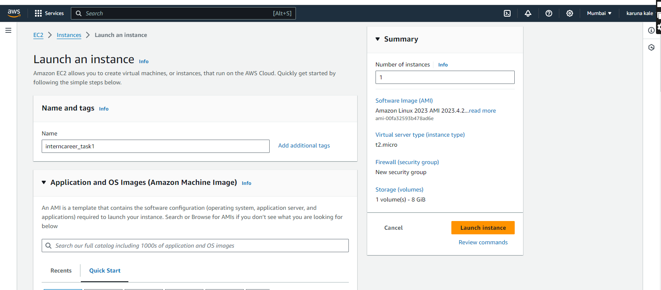

Slide 6
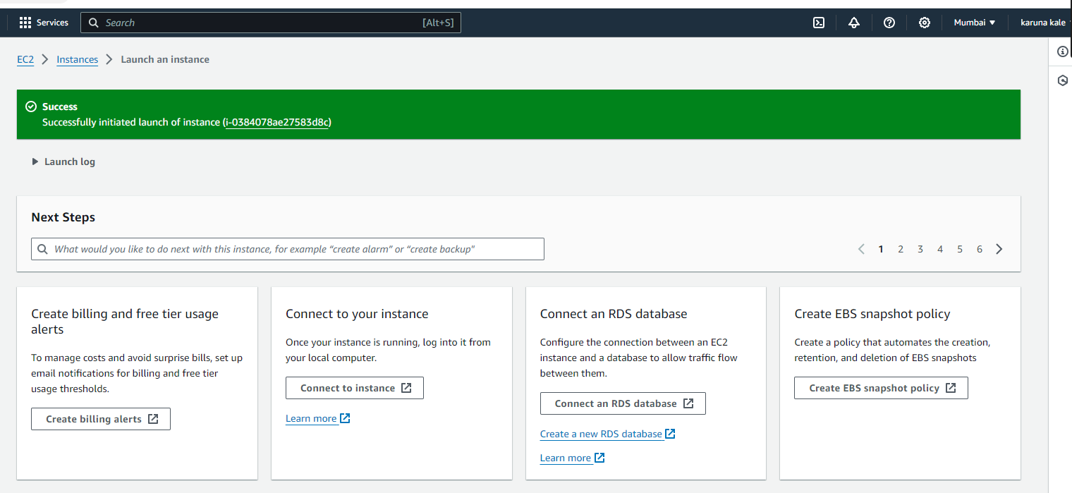

Slide 7
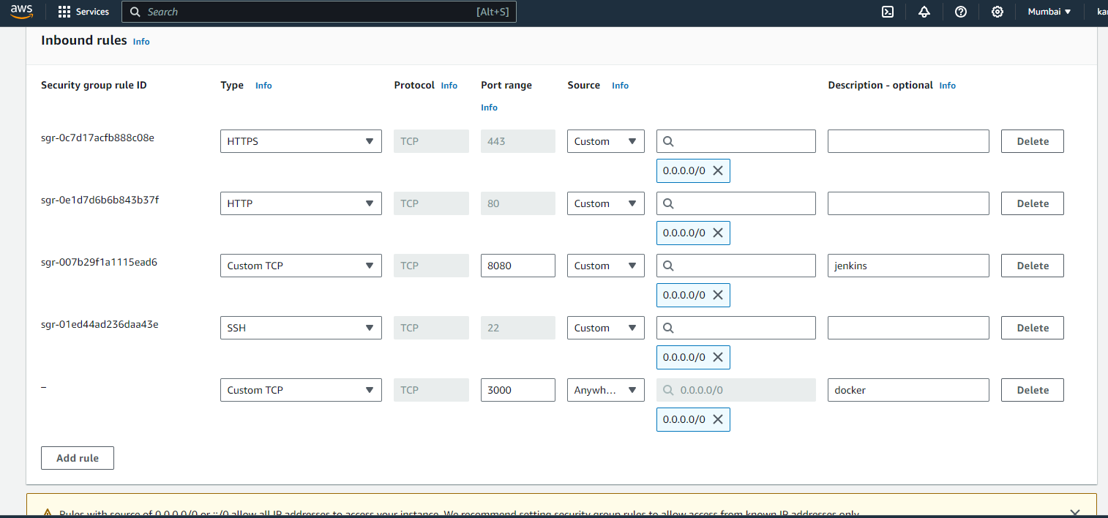

Slide 8
2.Setup jenkins
JENKINS:- Jenkins is a self-contained, open source automation server which can be used to automate all sorts of tasks related to building, testing, and delivering or deploying software.
Jenkins can be installed through native system packages, Docker, or even run standalone by any machine with a Java Runtime Environment (JRE) installed.

Slide 9
• In Continuous Integration after a code commit, the software is built and tested immediately.
• In a large project with many developers, commits are made manytimes during a day.
• With each commit code is built and tested.
• If the test is passed, build is tested for deployment.
• If deployment is a success, the code is pushed to production.
• This commit, build, test, and deploy is a continuous process and hence the name continuous integration or deployment.

Slide 10
JENKINS INSTALLATION COMMANDS
To install Jenkins we first need java to be installed in the machine
So 1st install java
Install JDK 8
$ sudo apt update
$ sudo apt install openjdk-11-jdk -y

Slide 11
To install Jenkins :
1.curl -fsSL https://pkg.jenkins.io/debian-stable/jenkins.io-2023.key | sudo tee /usr/share/keyrings/jenkins-keyring.asc > /dev/null
2.echo deb [signed-by=/usr/share/keyrings/jenkins-keyring.asc] https://pkg.jenkins.io/debian-stable binary/ | sudo tee /etc/apt/sources.list.d/jenkins.list > /dev/null
3.sudo apt-get update
4.sudo apt-get install jenkins

Slide 12
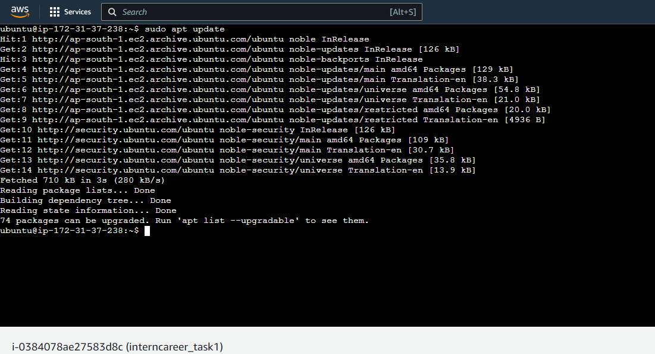

Slide 13
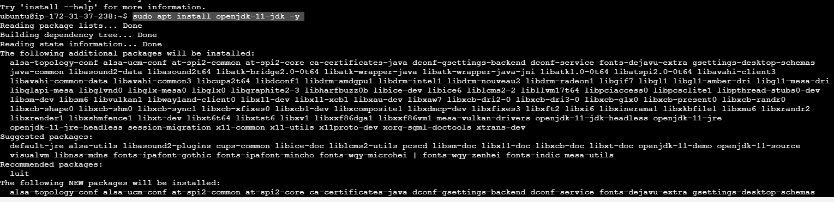
Installing java

Slide 14
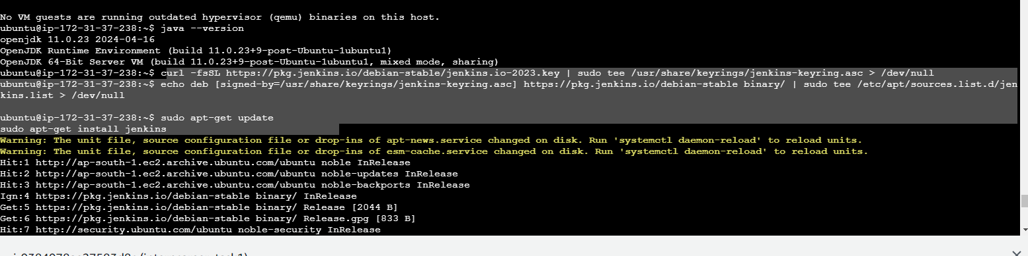
Installing Jenkins and it packages:

Slide 15
3. Acess Jenkins
Open a web browser and navigate to Jenkins login page
https://ec2-public-ip:8080/

Slide 16
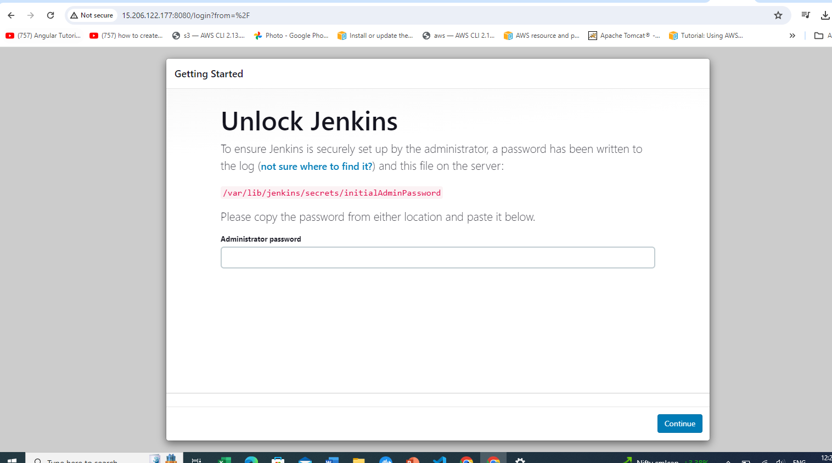
Configuring Jenkins:

Slide 17
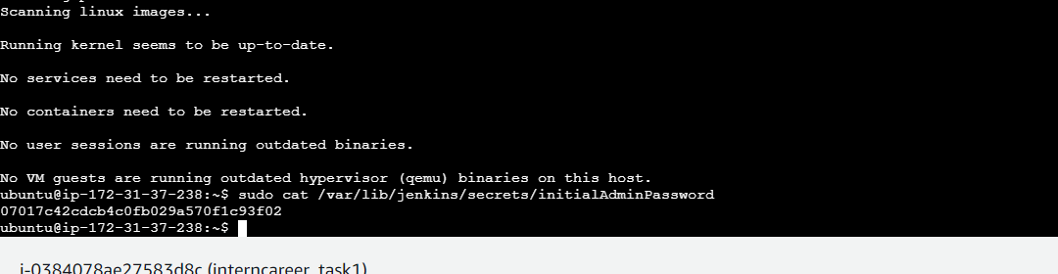


Slide 18
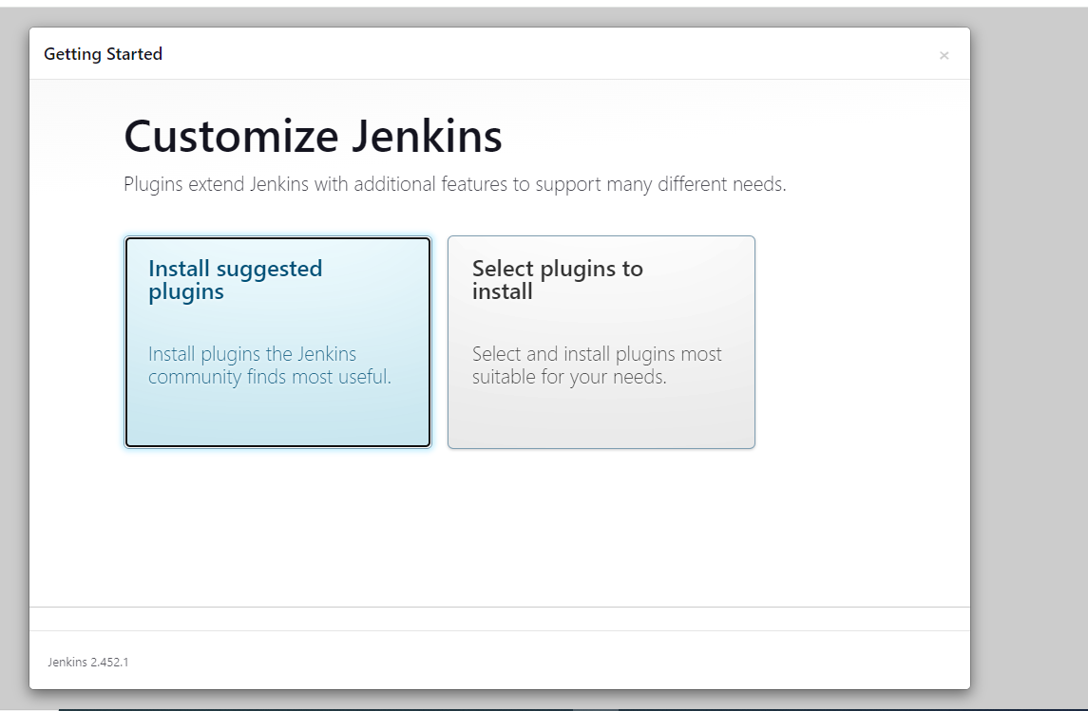
Installing the required pulgings:

Slide 19
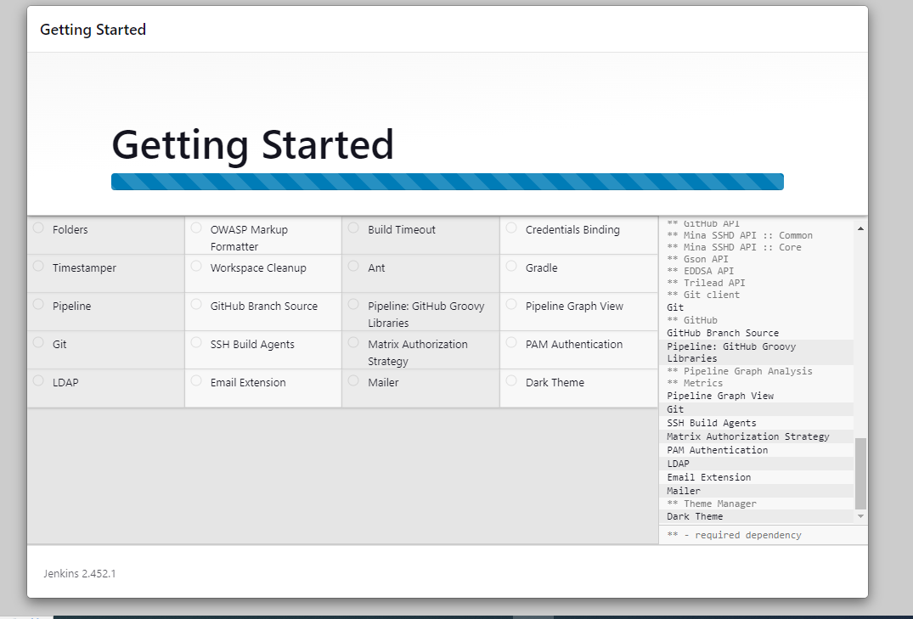

Slide 20
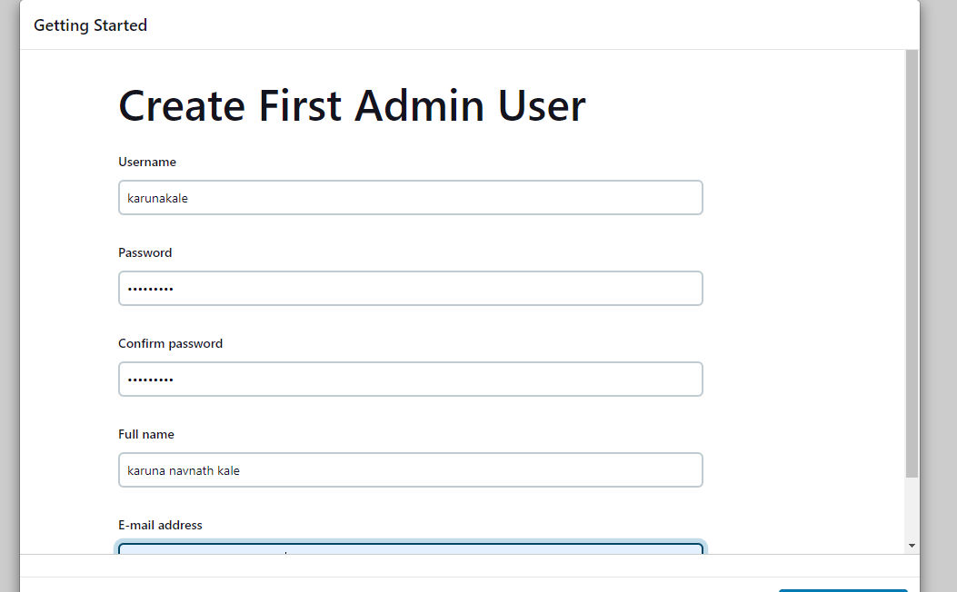

Slide 21
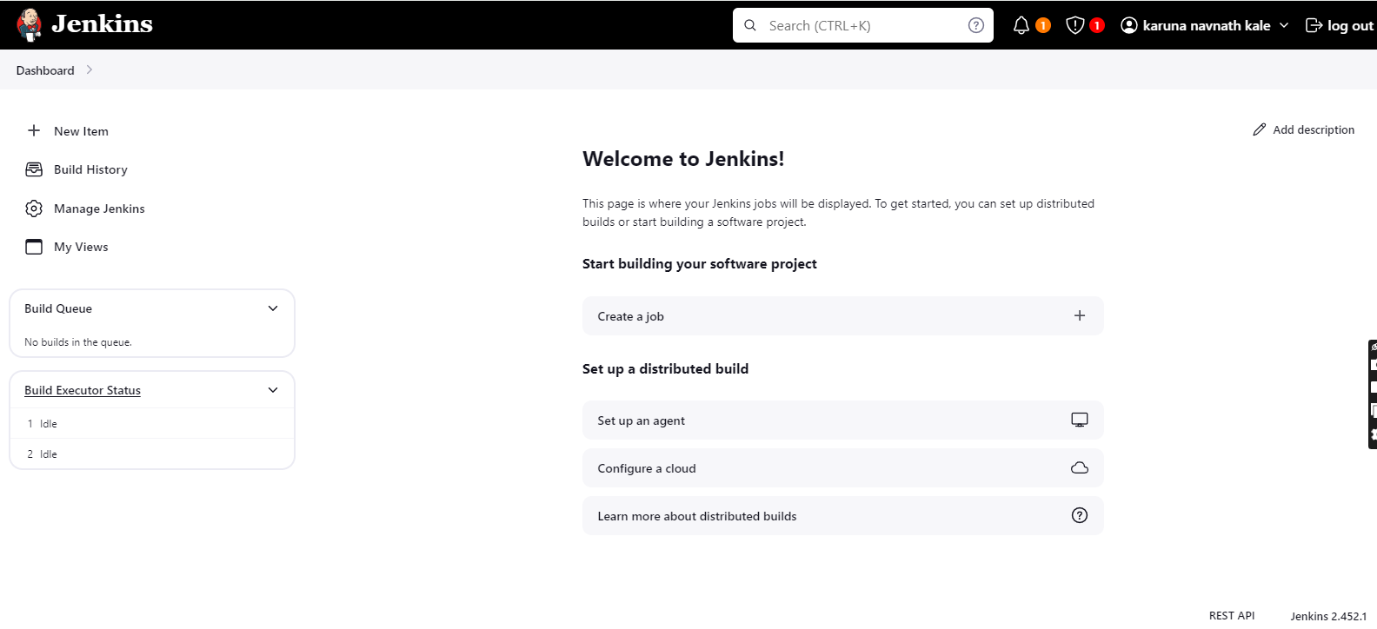

Slide 22
Install Required Plugins:
In Jenkins, go to "Manage Jenkins" > "Manage Plugins."
Install necessary plugins (e.g., Pipeline, GitHub, Docker)

Slide 23
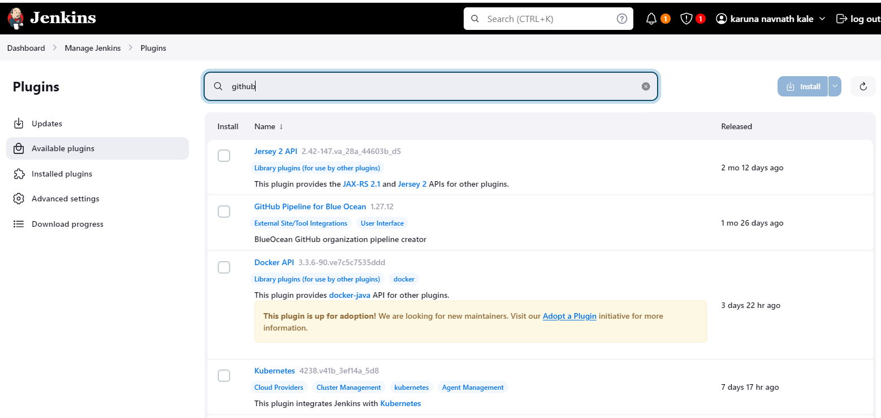

Slide 24
Jenkins Pipeline
Jenkins Pipeline is a powerful feature that allows users to define their build pipelines as code using a domain-specific language (DSL).
This enables users to create complex, multistage pipelines that are version-controlled, maintainable, and easy to understand.

Slide 25
Create Jenkins Pipeline
• Create a new Jenkins job.
• Select "Pipeline" as the job type.
• Write your Groovy script in the pipeline configuration

Slide 26
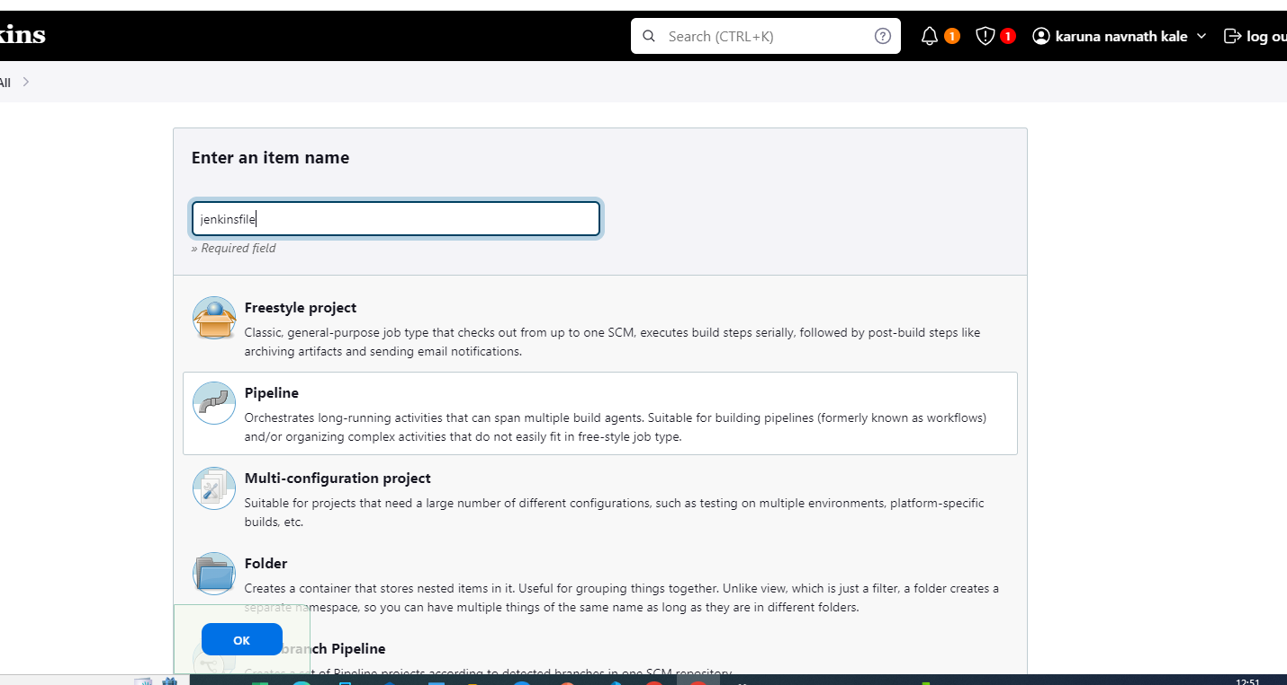



Slide 27
4. Configure Version Control:
a. Set up a Git repository on GitHub or GitLab to host the web application code.
The first step in setting up a CI/CD pipeline is to store your source code in a repository.
This will allow you to manage and track changes to your code over time.
If you haven't already, create a repository for your web application in a Git-based repository management platform, such as GitHub or GitLab.
Make sure to push your latest code changes to the repository.
Gitclone:
https://github.com/karunakale/interncarrier_task1.git

Slide 28
Creating a Sample web application
// app.js
const http = require('http');
const server = http.createServer((req, res) => {
res.statusCode = 200;
res.setHeader('Content-Type', 'text/plain');
res.end('Hello, this is a basic Node.js application!\n');
});
const PORT = process.env.PORT || 3000;
server.listen(PORT, () => {
console.log(`Server is running on port ${PORT}`);
});

Slide 29
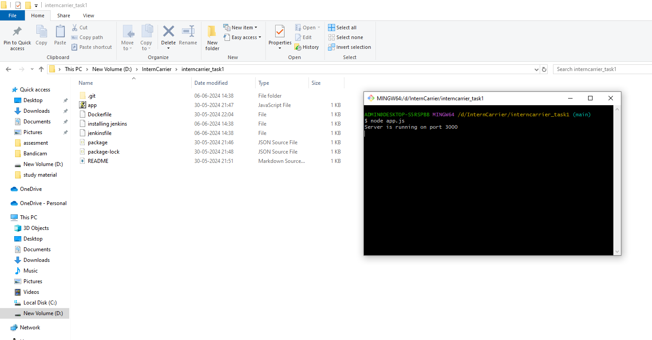
Running the application locally:

Slide 30
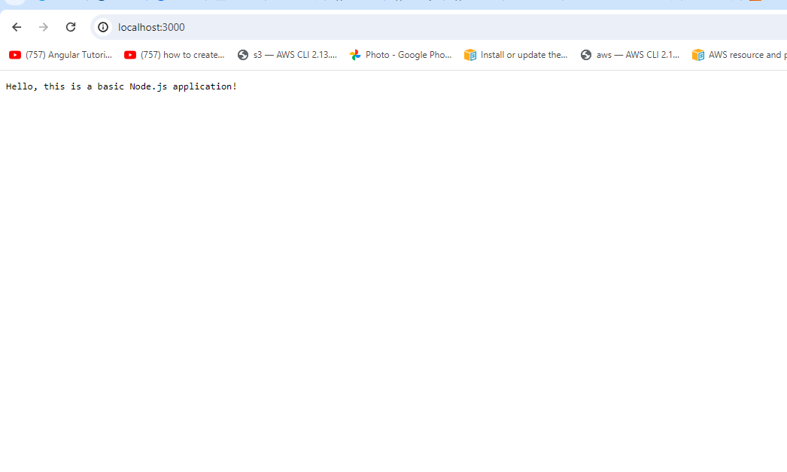
Application runs locally on 3000 port

Slide 31
creating a sample web application and pushing it to a Git repository
1. Choose a Technology Stack: Decide on the technology stack for your web application. For a simple example, you could use HTML/CSS/JavaScript for the frontend and Node.js for the backend.
2. Set Up Your Development Environment: Install Node.js and npm (Node Package Manager) on your machine if you haven't already.

Slide 32
3.Create Your Web Application: Create a new directory for your project and navigate into it. Create a Node.js file .
Initialize a Git Repository: Run git init in the project directory to initialize a new Git repository.
4.Add Your Files to the Repository: Use git add . to stage all files in the directory for committing.
Or
5.Create the files in the visual studio and then push the files directly from the visual studio to the repository as I have soon below .

Slide 33
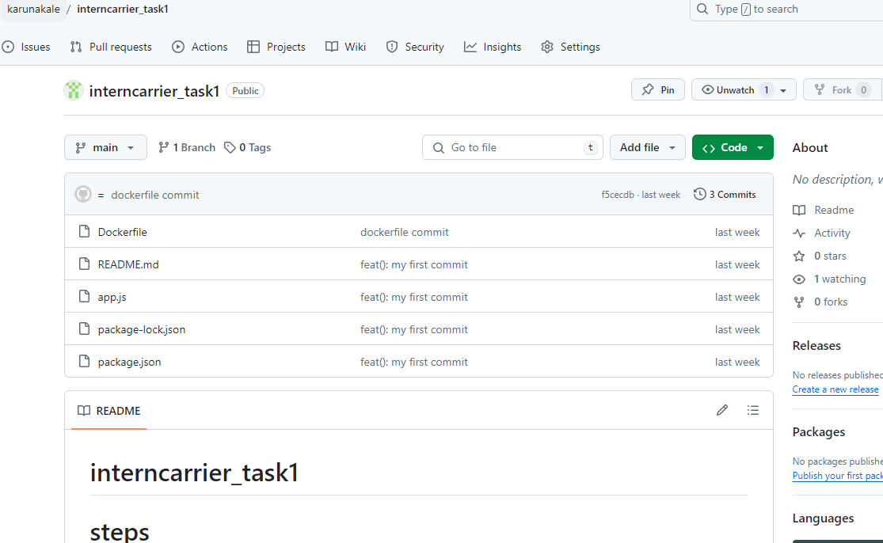
Before committing the changes :

Slide 34
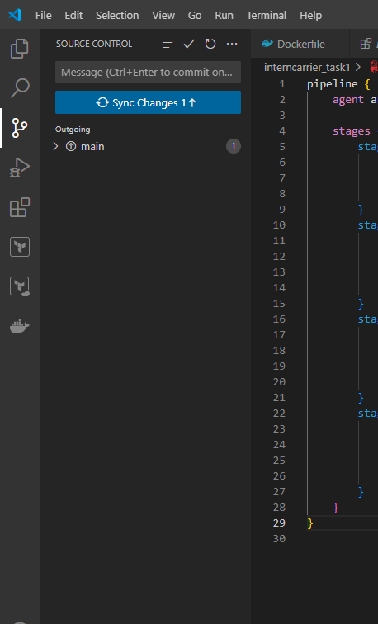
Committing the changes direct from the vscode

Slide 35
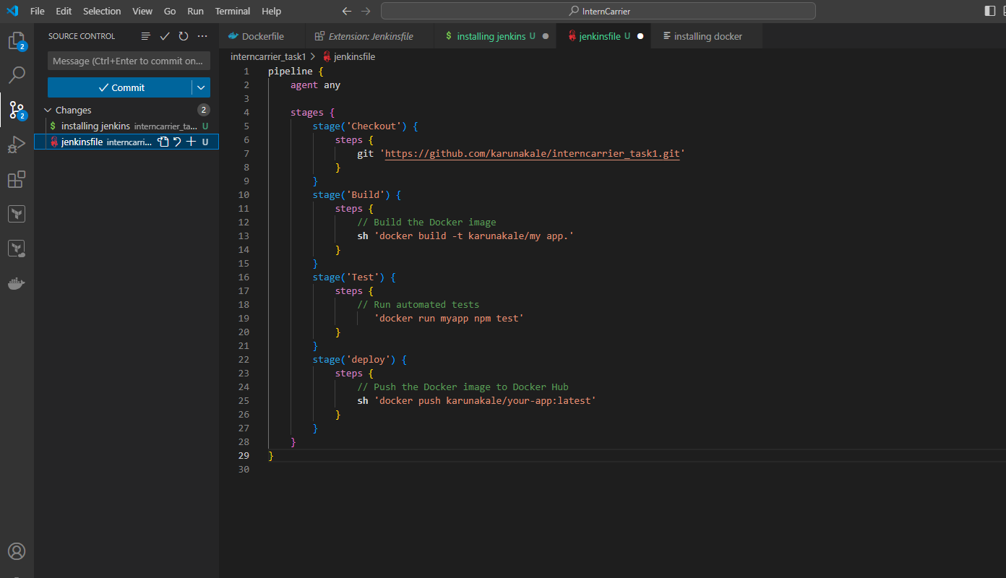

Slide 36
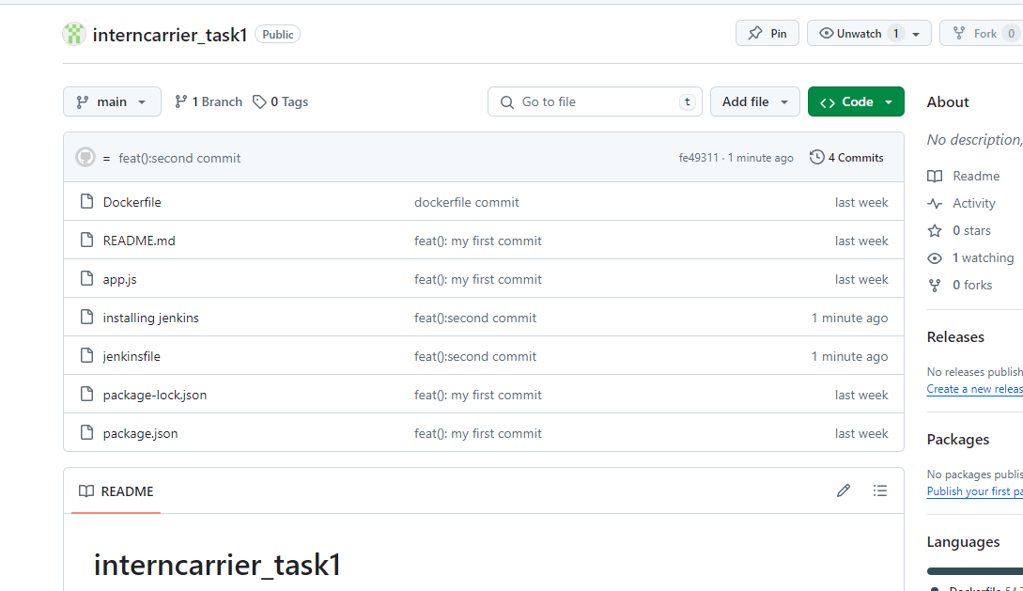
After committing the changes direct from the vscode:

Slide 37
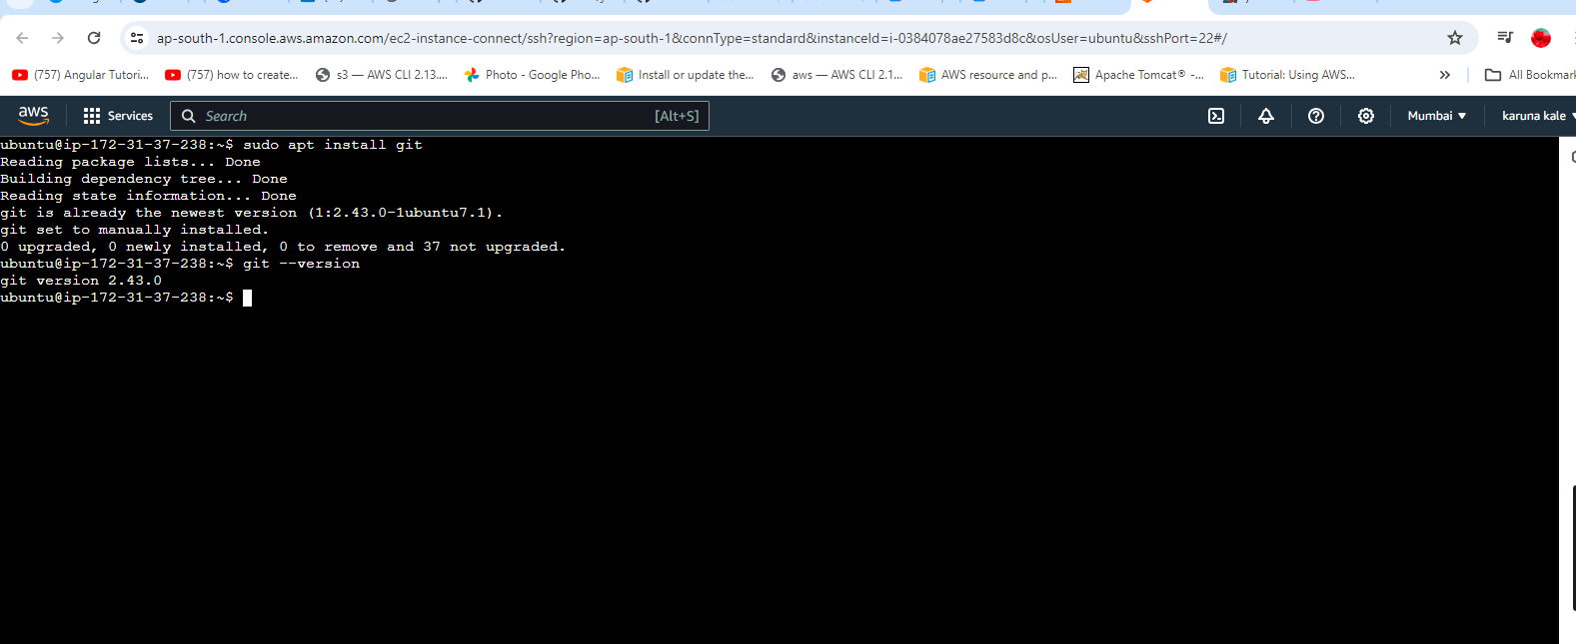
Installing git:

Slide 38
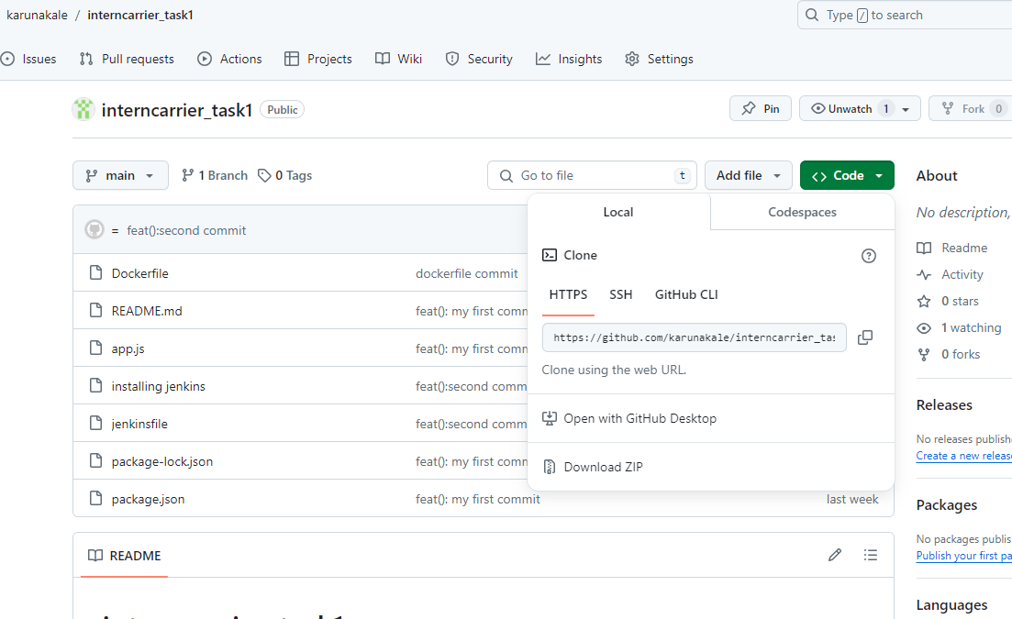
Git clone the repository:

Slide 39
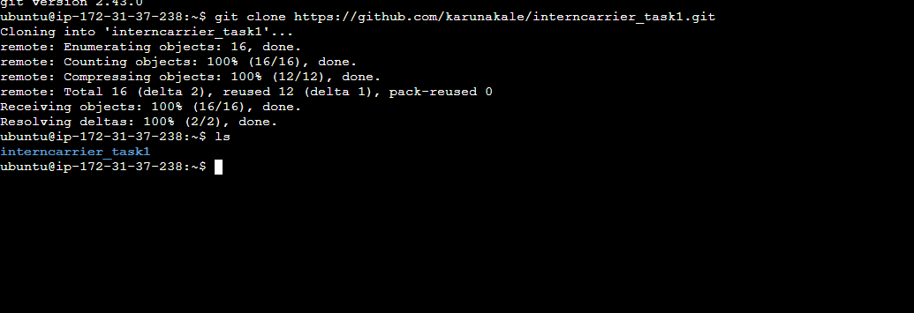

Slide 40
5. Create Jenkins Pipeline:
a. Write a Jenkinsfile (declarative or scripted pipeline) to define the CI/CD stages:
i. Build Stage: Pull the code from the Git repository, compile/build the application.
ii. Test Stage: Run automated tests (unit tests, integration tests, etc.) on the built application.
iii. Deploy Stage: Package the application into a Docker container, push the container to Docker

Slide 41
Jenkins file
pipeline {
agent any
environment {
registryCredential = 'fff7dd97-46b0-492a-b321-730e5dda70fd’
dockerImage = 'karunakale/interncarrer_task1:latest’
}
stages {
stage('Checkout') {
steps {
script {
// Cloning the Git repository
git branch: 'main', credentialsId: '6851e16d-095f-4a92-9d22-0f8e671a69ee', url: 'https://github.com/karunakale/interncarrier_task1.git'
}
}
}
stage('Build') {
steps {
script {

Slide 42
def dockerImage
// Building Docker image
dockerImage = docker.build("karunakale/interncarrer_task1")
}
}
}
stage('Tag and Push to Docker Registry') {
steps {
script {
// Login to Docker Hub
sh 'docker login -u karunakale -p Karuna@pradip15'
// Tag the Docker image
sh 'docker tag karunakale/interncarrer_task1:latest karunakale/interncarrer_task1:v1.0'
// Push the Docker image to Docker Hub
sh 'docker push karunakale/interncarrer_task1:latest'
}
}
}
stage('Deploy') {
steps {
script {
// Deploying the Docker image
sh 'docker run -d -p 3000:3000 karunakale/interncarrer_task1:latest'
}
}
}
}
}

Slide 43
6. Configure Docker:
Docker :-
Docker is a tool designed to make it easier to create, deploy, and run applications by using containers. Containers allow a developer to package up an application with all of the parts it needs, such as libraries and other dependencies, and ship it all out as one package. By doing so, thanks to the container, the developer can rest assured that the application will run on any other Linux machine regardless of any customized settings that machine might have that could differ from the machine used for writing and testing the code. In a way, Docker is a bit like a virtual machine.

Slide 44
But unlike a virtual machine, rather than creating a whole virtual operating system.
• Docker allows applications to use the same Linux kernel as the system that they're running on and only requires applications be shipped with things not already running on the host computer.
• This gives a significant performance boost and reduces the size of the application.
• And importantly, Docker is open source.
• This means that anyone can contribute to Docker and extend it to meet their own needs if they need additional features that aren't available out of the box.

Slide 45
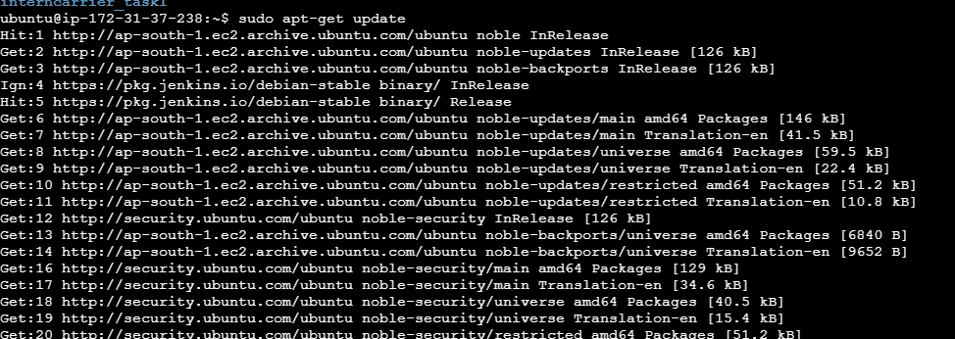
Installing docker:

Slide 46
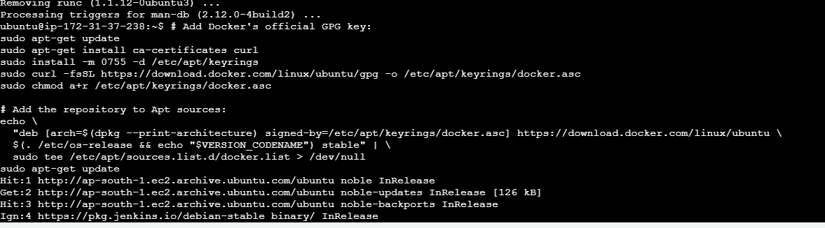
Installing docker:

Slide 47
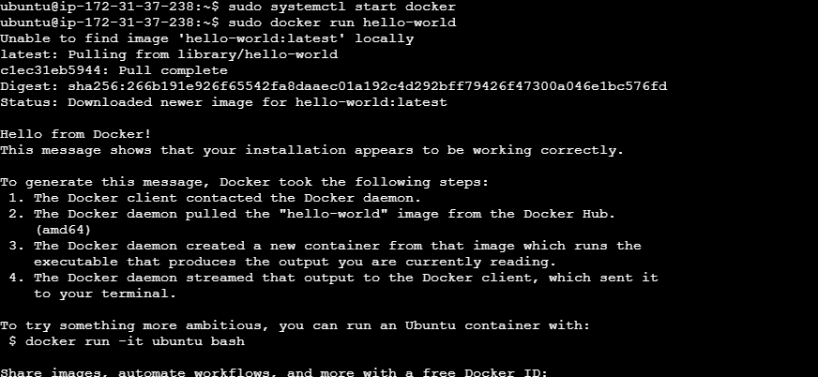

Slide 48
Creating a Docker file
Step 1 - Create a new directory
mkdir node-app
cd node-app
Step2-Create a file named Dockerfile
touch Dockerfile
Step3- Open the "Dockerfile" file in a text editor and add the following lines:
# Use the official Node.js image as the base image
FROM node:14
# Set the working directory in the container
WORKDIR /usr/src/app
# Copy package.json and package-lock.json to the working directory
COPY package*.json ./
# Install application dependencies
RUN npm install
# Bundle app source
COPY . .
# Expose the port your app runs on
EXPOSE 3000
# Define the command to run your app using npm
CMD [ "node", "app.js" ]

Slide 49
Step4- Start docker & Build docker image from dockerfile
docker build -t node-app .
This command builds a new Docker image with the tag “node-app" using the Dockerfile in the current directory.
Step5 - Run docker container from the image
docker run -p 3000:3000 node-app
This command maps port 3000 on the host machine to port 3000 inside the container, allowing external access to the Node.js application running within the container.
OR

Slide 50
If we have already created the dockerfile in the visual studio in the web application folder then after cloning the repository,
Change the file
-> $ cd interncarrier_task1
Then build the image here
->$ sudo docker built –t node-app .
After the built of image, run the container
->$ sudo docker run –p 3000:3000 node-app
Then container will run and the server will start running on the given host.

Slide 51
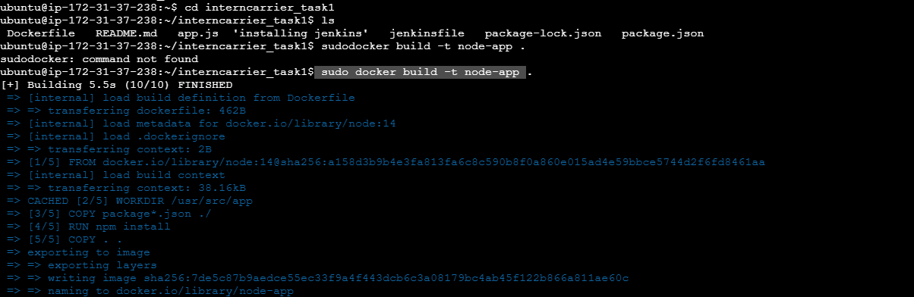

Slide 52
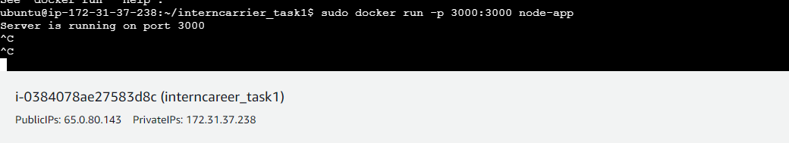

Slide 53
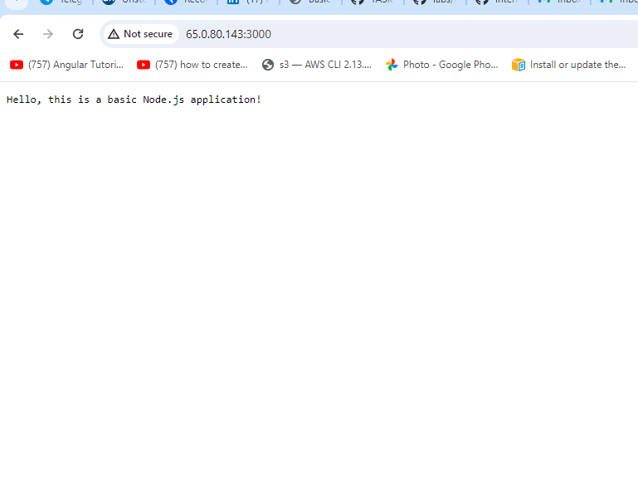

Slide 54
7. Integrate Jenkins with GitHub/GitLab:
GitHub Integration:
-> Go to your GitHub Account.
->Under “Account Settings," select "Developer settings."
->Generate a classic token and copy it.

Slide 55
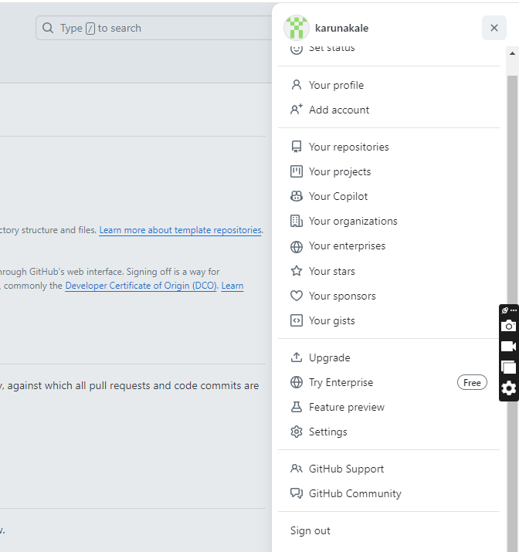


Slide 56
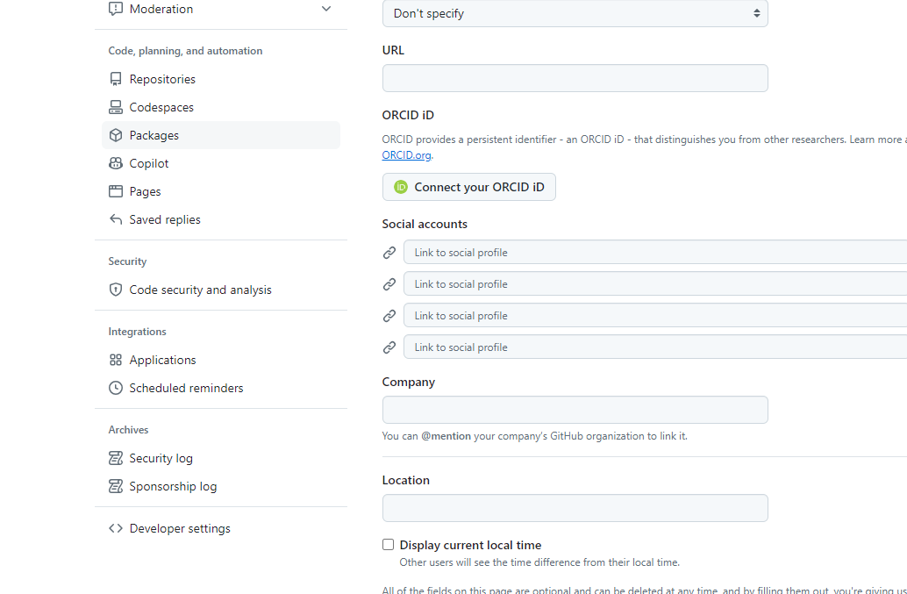


Slide 57
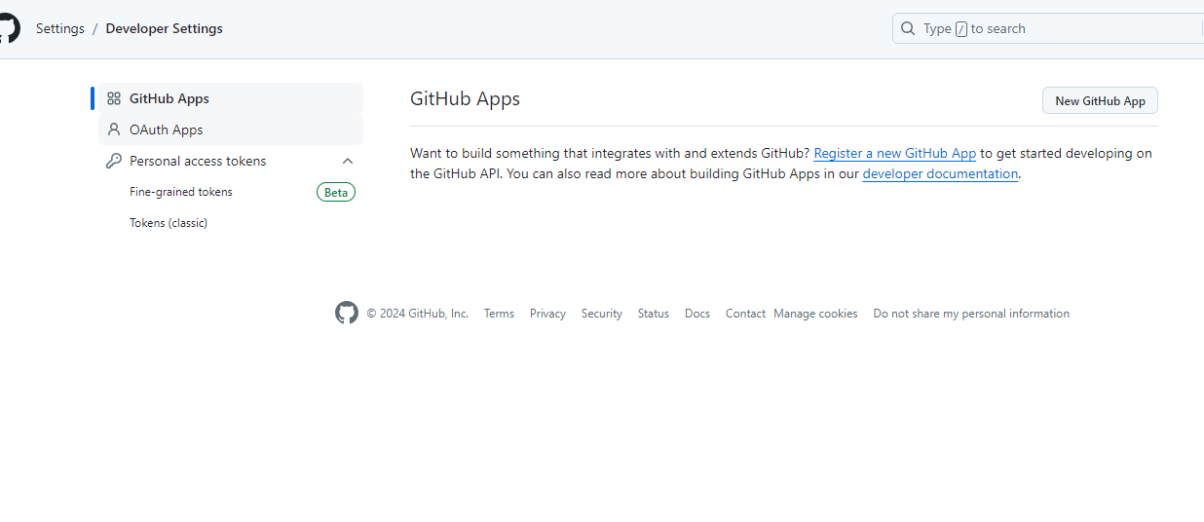



Slide 58
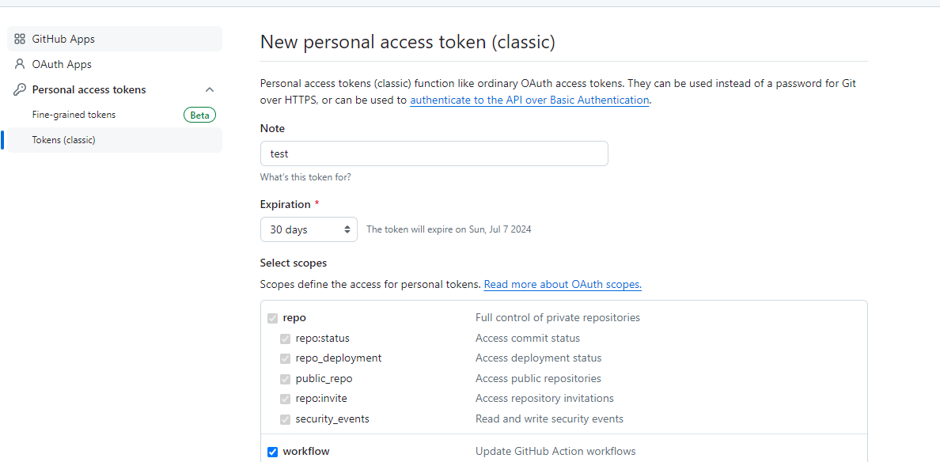

Slide 59
Configure Jenkins with GitHub Credentials:
In Jenkins, go to "Manage Jenkins" > "Credentials.“
->system ->globalcredentials-> add credentials
Add your GitHub username and paste the Github token as the password.

Slide 60
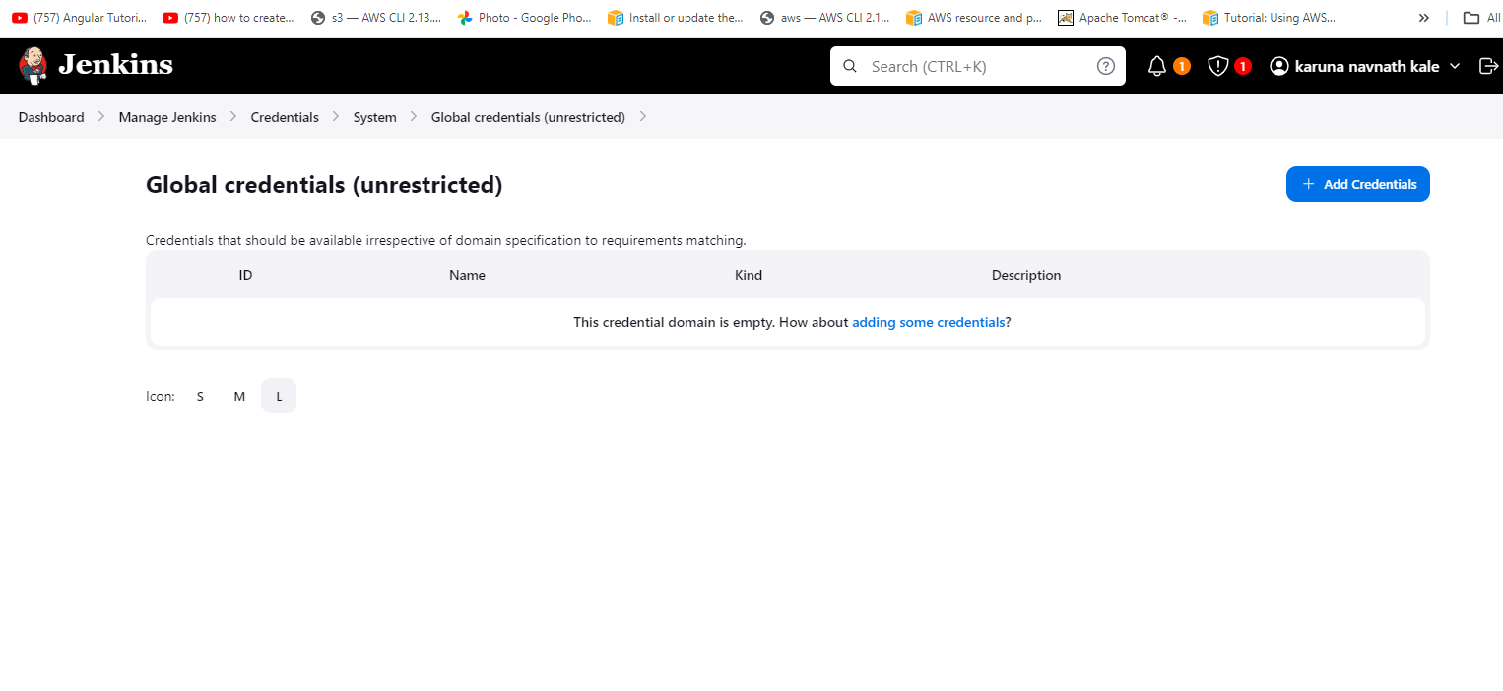


Slide 61
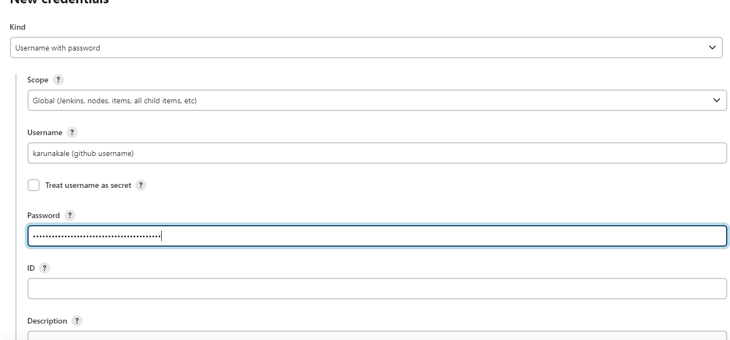



Github username
Github token

Slide 62
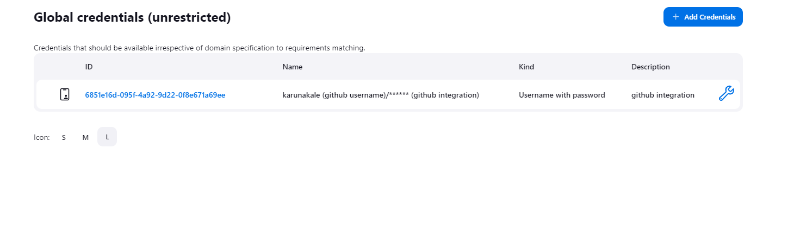

Slide 63
DockerHub Integration:
**Dockerhub Integration**
Go to DockerHub.
click on security.
Generate an access token.

Slide 64
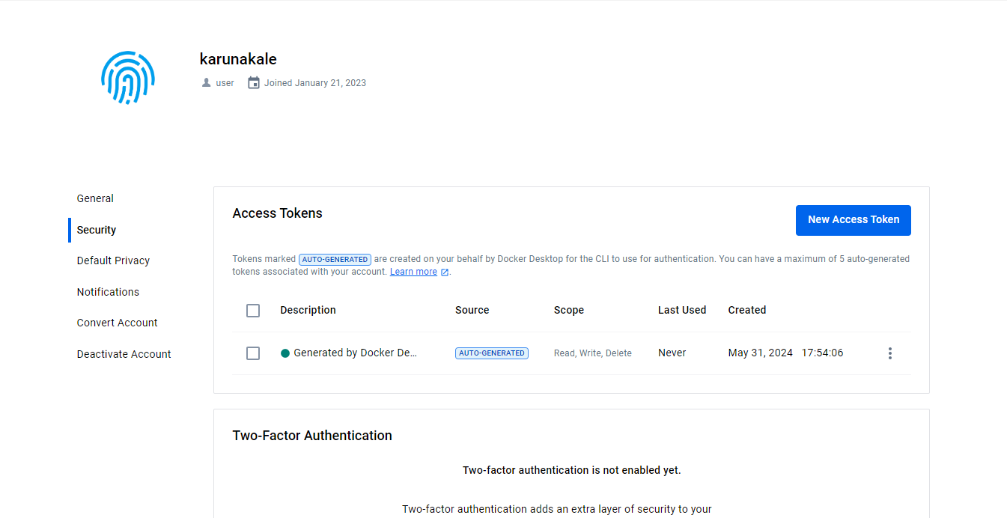


Slide 65
Configure DockerHub in Jenkins:
In Jenkins, go to "Manage Jenkins" > “credentials"
->system ->globalcredentials-> add credentials
Add your DockerHub username and paste the token.

Slide 66
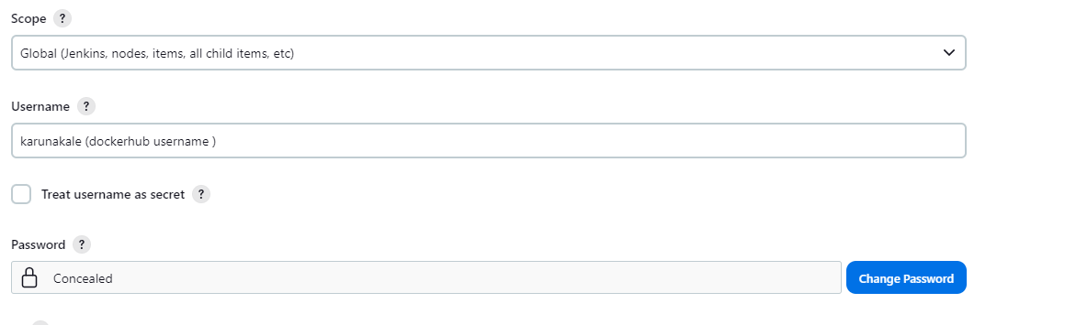

Slide 67
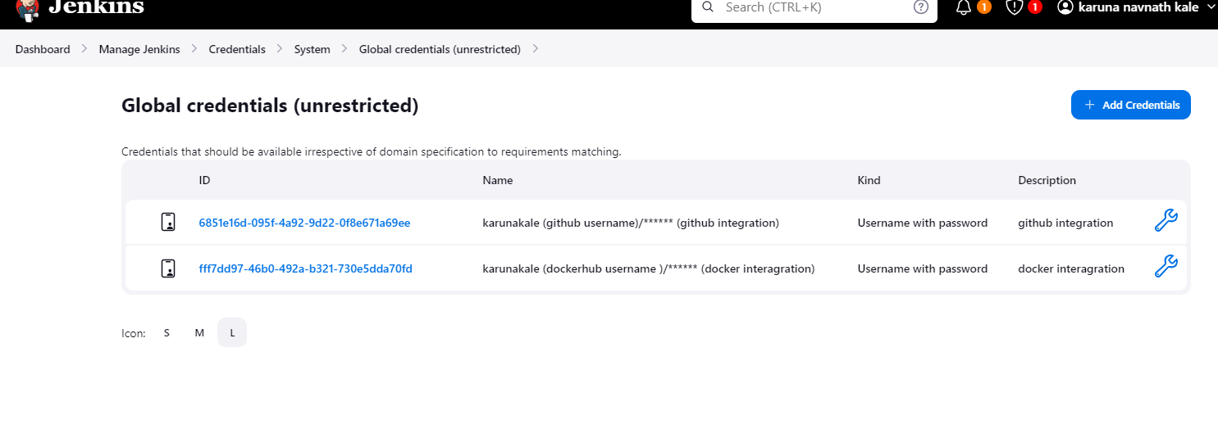

Slide 68
Adding Webhook in Github
Go to your GitHub repository.
Under "Settings," select "Webhooks."
Click on "Add webhook."
Set the payload URL to your Jenkins server's URL followed by /github-webhook/.
Select the events you want to trigger the webhook (e.g., Push events).
Save your webhook configuration.

Slide 69
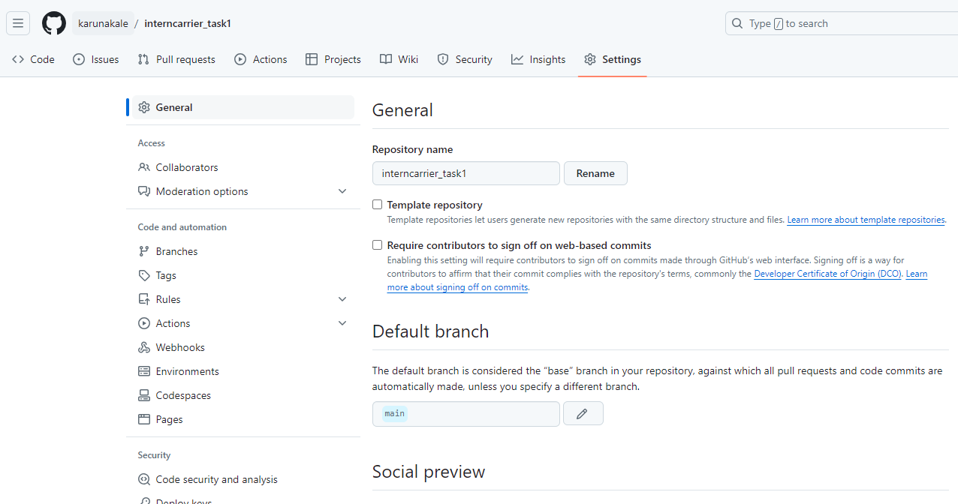


Slide 70
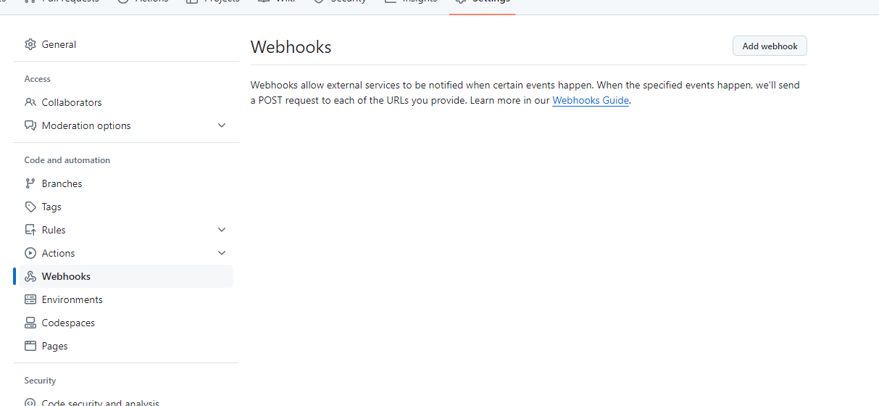


Slide 71
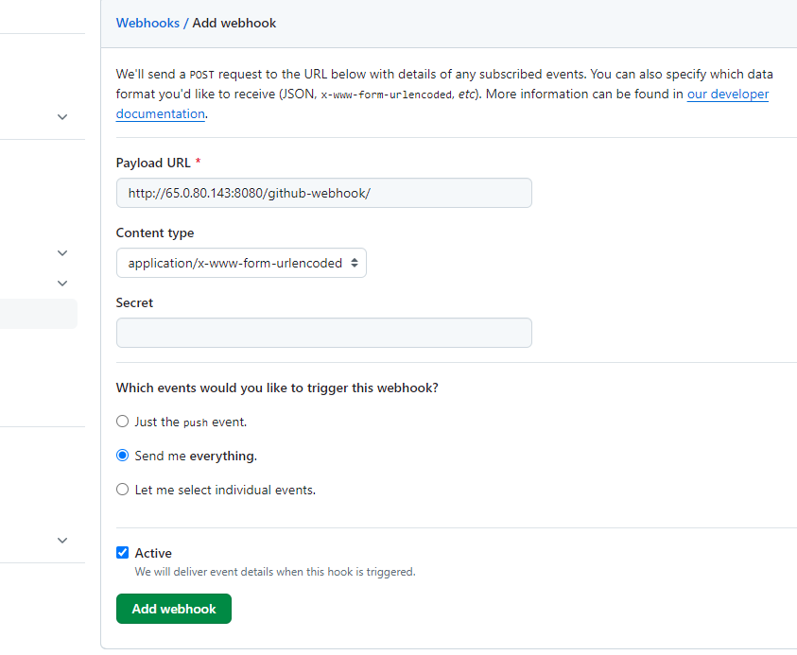

Slide 72
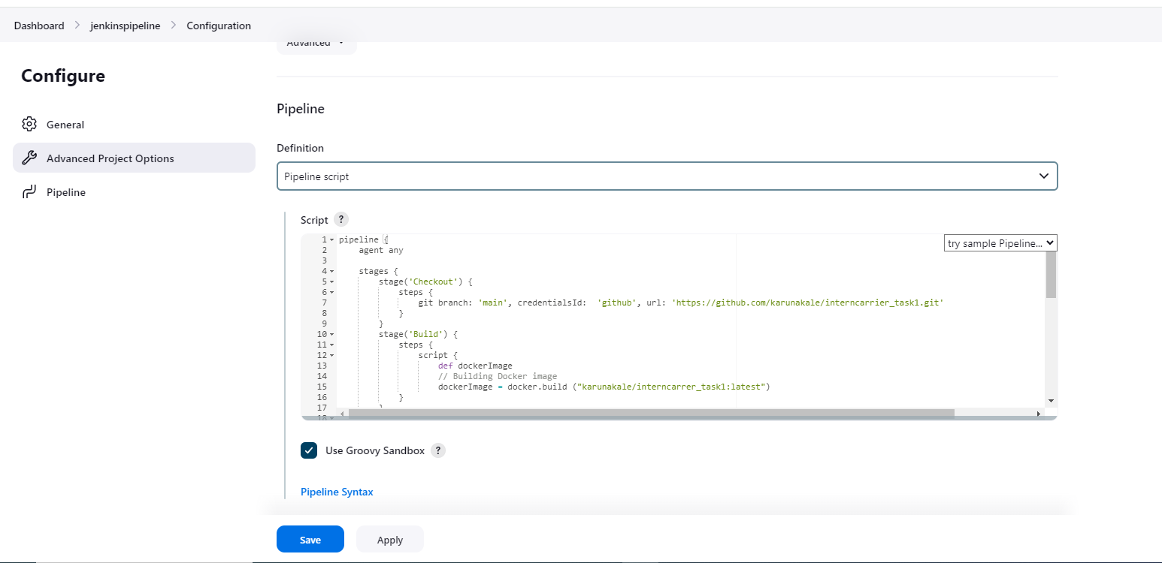
Setting up the pipeline:

Slide 73
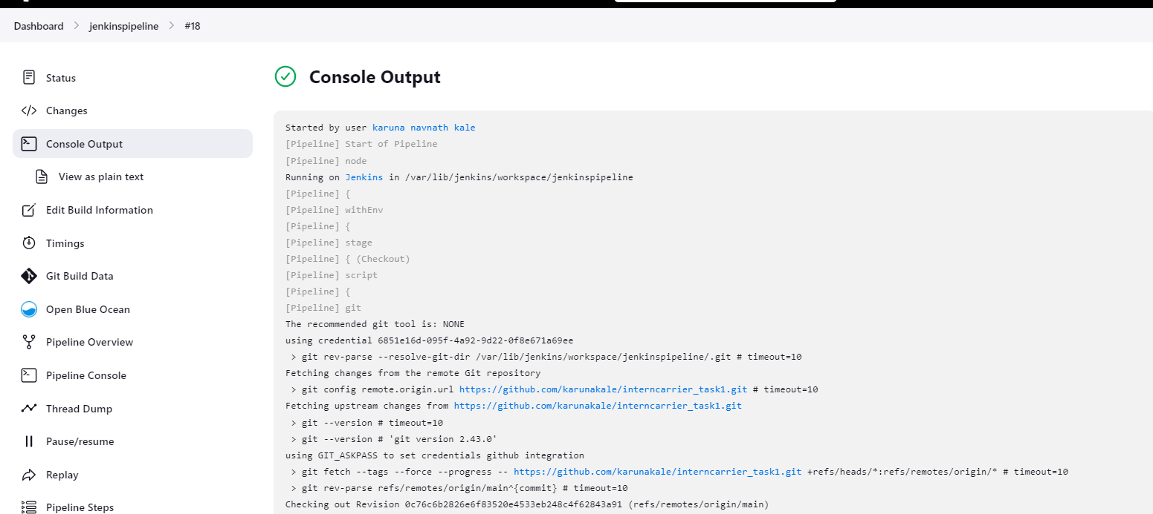
Jenkins pipeline build

Slide 74
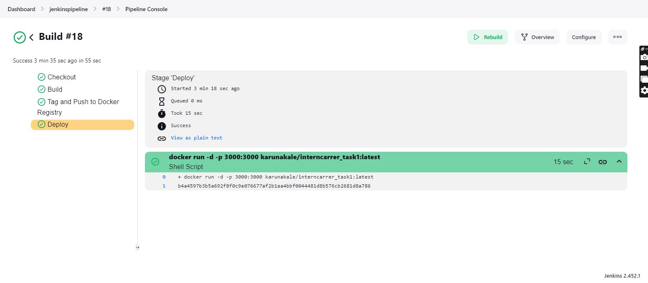
Here it shows that the build is successful

Slide 75
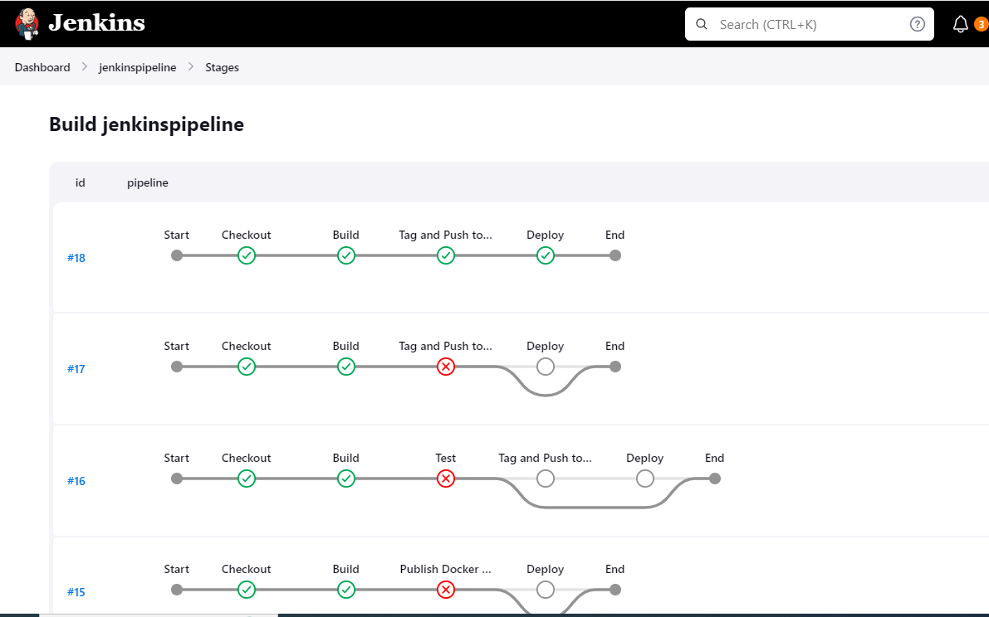
Here are the stages shown which are successful

Slide 76
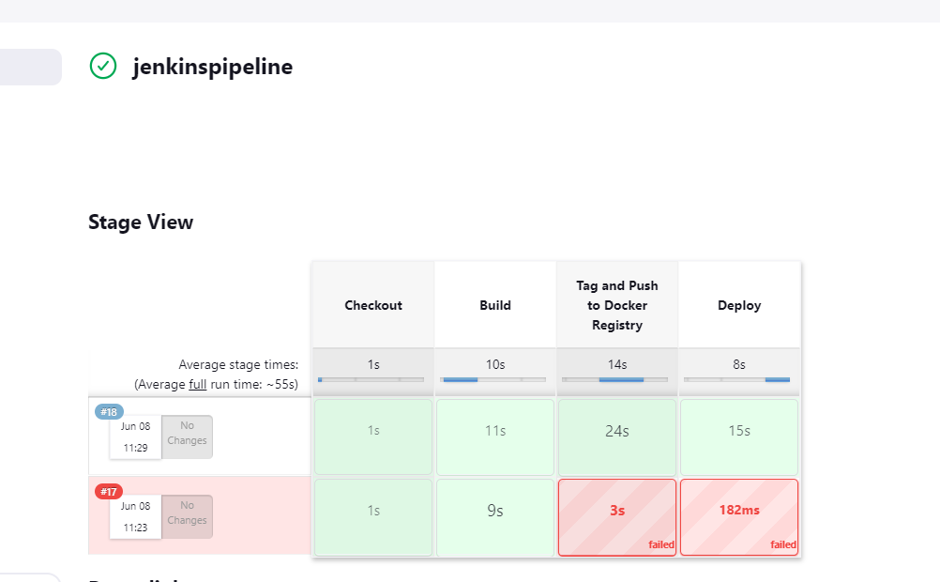

Slide 77
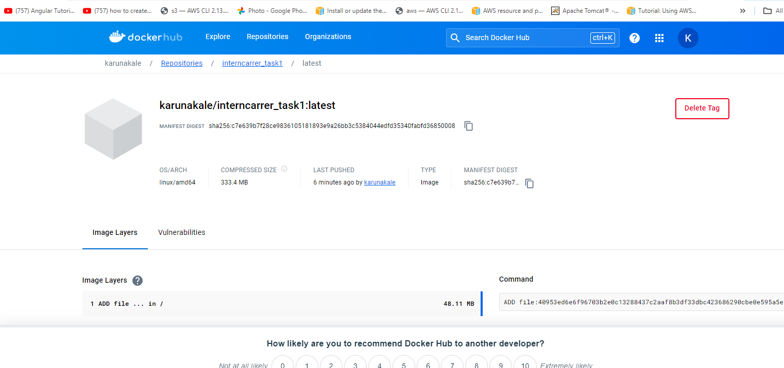
After the build the docker image is ready and stored in the repo

Slide 78
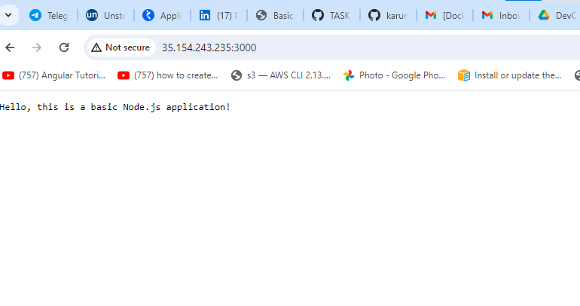
After the deployment of the application

Slide 79
Conclusion
With a CI/CD pipeline in place, you can ensure that changes to your web application are integrated and deployed quickly and with high quality. By automating the build, test, and deployment process, you can reduce the risk of bugs and downtime and improve the overall stability of your application.

Slide 80
Resources and References:
Jenkins Tutorials and Documentation:
• Jenkins Documentation
➢ Docker Guides and Resources:
• Docker Documentation
➢ GitHub/GitLab Guides:
• GitHub Guides • GitLab Documentation
➢ CI/CD Pipeline Examples:
• Sample Jenkins Pipelines – GitHub • CI/CD Pipeline with Jenkins, Docker, and GitHub - Medium Article

